Slide 1
Working with Inheritance
Principles of Object-Oriented Programming

Slide 2
Agenda
Introducing the principles of Object- Oriented Programming Abstraction in Java How to design a class to encapsulate data
How to extend a class with another class

Slide 3
What is Object-Oriented Programming?

Slide 4


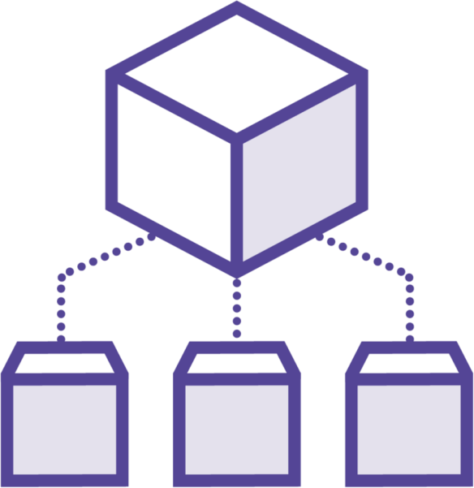

The Four Principles of OOP
Abstraction
Encapsulation
Inheritance
Polymorphism

Slide 5
Abstracting Concrete Ideas

Slide 6

Abstraction
Abstraction is about finding the concepts you need for the application you are developping

Slide 7

Your application computes statistics on cities
A city is made of so many things…
What you need is only the name of the city And its population
This is your abstraction

Slide 8
class City {
String name; int population;
}
A City is modeled by a class
That defines a state composed of:
the name of the city
the population

Slide 9
Encapsulating Data

Slide 10

Encapsulation
Encapsulating the data stored in your classes consists in hiding it from the users of this class

Slide 11
class City | {
private private } | String name; int populatio
n;
A City is modeled by a class
That defines a state composed of:
the name of the city
the population

Slide 12
Exposing the fields of your classes is a bad practice
Encapsulating consists in hiding the fields And expose their value through accessors

Slide 13

Why is it a bad practice?
Suppose you need the population to be greater than zero
Exposing the population field prevents you from being able to validate it

Slide 14
class City {
private String name; private int population;
public City(String name, int population) { this.name = name;
if (population < 0) {
throw new IllegalArgumentException(
"Population cannot be a negative number"); this.population = population;
}
public int getPopulation() { return this.population;
}
}

Slide 15
class City {
private String name; private int population;
public String getName() { return this.name;
}
public int getPopulation() { return this.population;
}
public int raiseBy(int percentage) {
this.population = this.population*(100 + percentage)/100; return this.population;
}
}

Slide 16



Demo
Let us write some code!
Let us see this City class in action

Slide 17
Module Wrap Up
What did you learn?
Abstraction
Designing classes to fit your needs
Keeping them simple
Encapsulation
Hiding the internal state of your class
To control what the outside code can do with it

